Slide 1
CSE 4513
Lec – 8
Modeling with UML

Slide 2

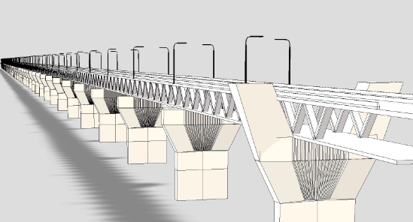
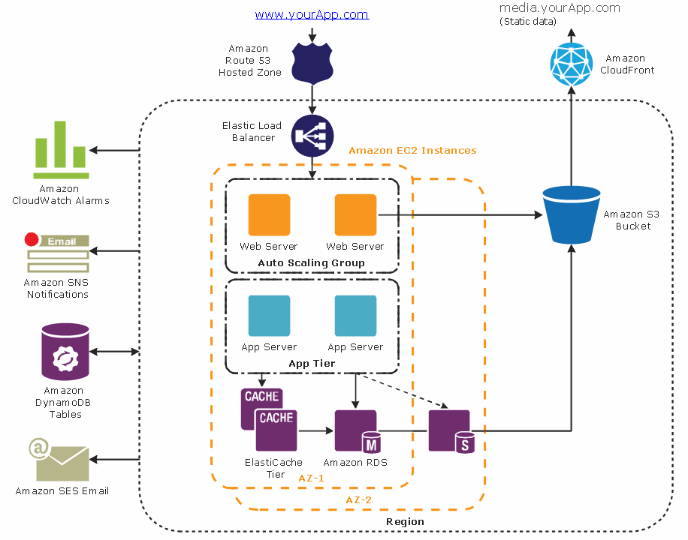
Model
A model is a simplification of reality.
Helps to better understand the system we are developing.
Through modeling, we achieve four aims.
  1. to visualize a system as it is or as we want it to be.
  2. to specify the structure or behavior of a system.
  3. to provide a template that guides us in constructing a system.
  4. to document the decisions we have made.
Creating models before software development is not just a luxury—it's a necessity.

Slide 3
UML Basics
Modeling Principles

Slide 4
What is modeling
Modeling consists of building an abstraction of reality.
Abstractions are simplifications because:
  They ignore irrelevant details and
  They only represent the relevant details.
What is relevant or irrelevant depends on the purpose of the model.

Slide 5
Why Modeling SW
Software is getting increasingly more complex
  Windows XP > 40 million lines of code
  A single programmer may not manage this amount of code in his entire coding life.
Code is not easily understandable by developers who did not write it
We need simpler representations for complex systems
  Modeling is a means for dealing with complexity

Slide 6

What is UML?
Unified Modeling Language
  OMG Standard
UML is a modeling language to express and design documents, software
  Particularly useful for OO design
  Independent of implementation language
  Object Management Group
The UML is a language for
· Visualizing
· Specifying
· Constructing
· Documenting

Slide 7
Why use UML
Visualization: Makes complex systems easier to understand with graphical representations.
Standardization: Ensures consistency and provides a common language for developers and stakeholders.
Documentation: Serves as detailed documentation for future reference and maintenance.
Design and Analysis: Helps in system design before coding, avoiding issues early.
Better Communication: Facilitates communication between technical and non-technical stakeholders.
Supports Development Processes: Fits with different methodologies, including Agile and Waterfall.

Slide 8
UML Diagrams

Slide 9
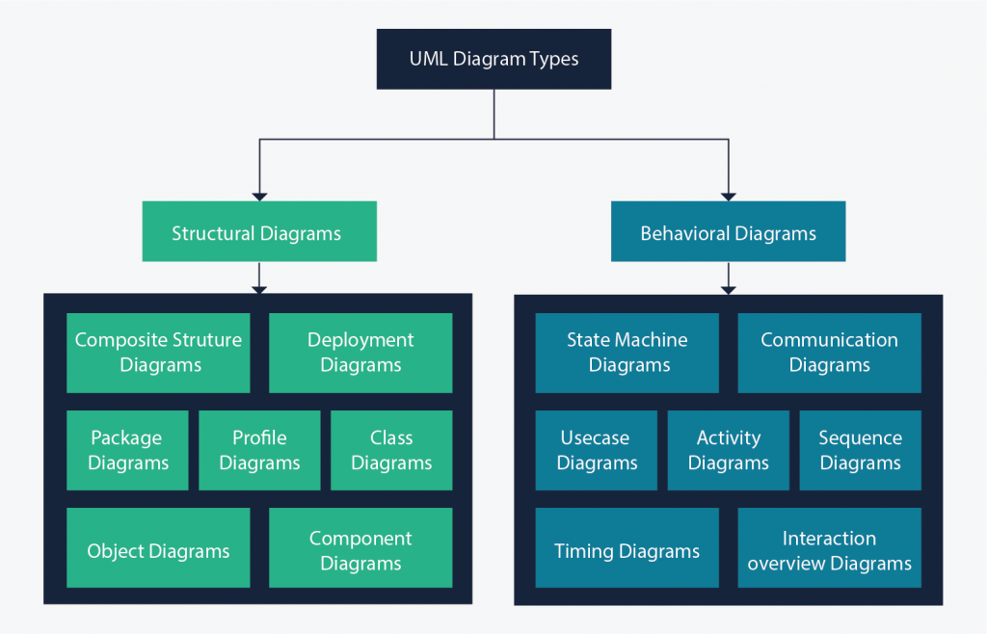
UML Diagram Types
There are two main categories: structure diagrams and behavioral diagrams.
show the things in the modeled system
show what should happen in a system

Slide 10
UML Diagrams
Use Case Diagrams
Class Diagrams
Object Diagrams
Package Diagrams
Sequence Diagrams
Activity Diagrams
State Transition Diagrams
Deployment Diagrams

Slide 11
Use Case Diagrams
Used during requirements elicitation to represent external behavior
The purpose of Use Case diagram
  To identify functions and how roles interact with them.
  For a high-level view of the system
  To identify internal and external factors

Slide 12
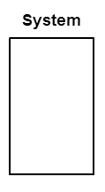
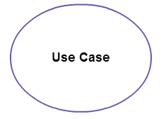
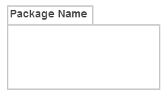
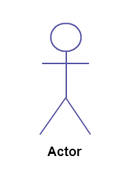
Use Case Diagrams (cont’d)
Use case diagrams consist of 4 objects.
  Actor
  Use case
  System
  Package
any entity that performs a role in one given system. This could be a person, organization or an external system and usually drawn like skeleton.
represents a function or an action within the system. It’s drawn as an oval and named with the function.
define the scope of the use case and drawn as a rectangle. This an optional element but useful when you’re visualizing large systems.
another optional element that is extremely useful in complex diagrams. Similar to class diagrams, packages are used to group together use cases.

Slide 13
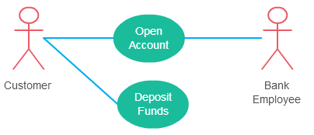
Use Case Diagrams (cont’d)
Relationships in Use Case Diagrams
There are five types of relationships in a use case diagram:
    Association between an actor and a use case
    Generalization of an actor
    Extend relationship between two use cases
    Include relationship between two use cases
    Generalization of a use case
This one is straightforward and present in every use case diagram. Few things to note.
An actor must be associated with at least one use case.
An actor can be associated with multiple use cases.
Multiple actors can be associated with a single use case.

Slide 14
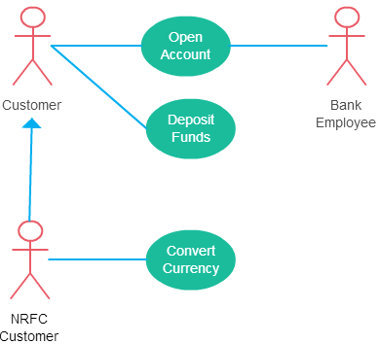
Use Case Diagrams (cont’d)
Relationships in Use Case Diagrams
There are five types of relationships in a use case diagram:
    Association between an actor and a use case
    Generalization of an actor
    Extend relationship between two use cases
    Include relationship between two use cases
    Generalization of a use case
Generalization of an actor means that one actor can inherit the role of the other actor.
The descendant inherits all the use cases of the ancestor.
The descendant has one or more use cases that are specific to that role

Slide 15
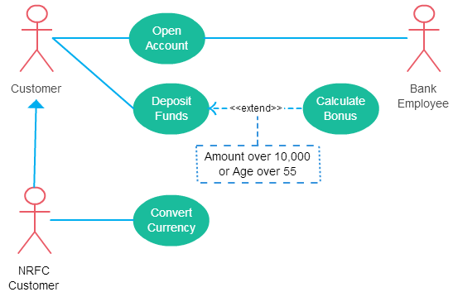
Use Case Diagrams (cont’d)
Relationships in Use Case Diagrams
There are five types of relationships in a use case diagram:
    Association between an actor and a use case
    Generalization of an actor
    Extend relationship between two use cases
    Include relationship between two use cases
    Generalization of a use case
it extends the base use case and adds more functionality to the system.
The extending use case is dependent on the extended (base) use case. .
The extending use case is usually optional
The extended (base) use case must be meaningful on its own

Slide 16
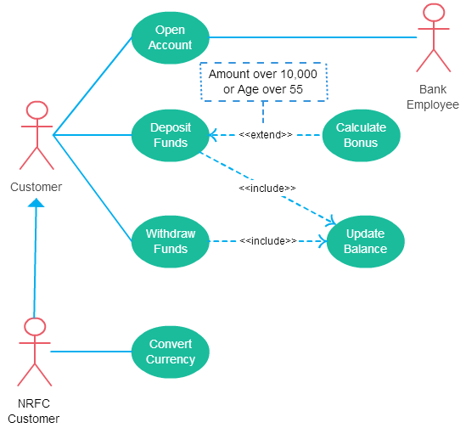
Use Case Diagrams (cont’d)
Relationships in Use Case Diagrams
There are five types of relationships in a use case diagram:
    Association between an actor and a use case
    Generalization of an actor
    Extend relationship between two use cases
    Include relationship between two use cases
    Generalization of a use case
show that the behavior of the included use case is part of the including (base) use case
The base use case is incomplete without the included use case.
The included use case is mandatory and not optional.

Slide 17
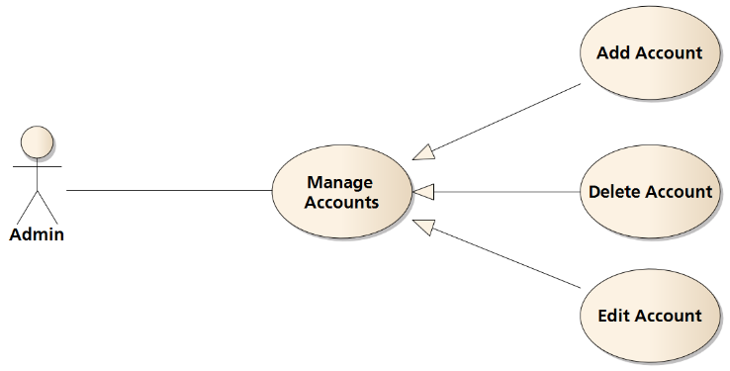
Use Case (cont’d)
Relationships in Use Case Diagrams
There are five types of relationships in a use case diagram:
    Association between an actor and a use case
    Generalization of an actor
    Extend relationship between two use cases
    Include relationship between two use cases
    Generalization of a use case
This is similar to the generalization of an actor.
This is used when there is common behavior between two or more use cases and also specialized behavior specific to each use case.

Slide 18
Use Case (cont’d)
How to create Use case diagram
Identifying Actors
Identifying Use Cases
Look for Common Functionality to use Include
Is it Possible to Generalize Actors and Use Cases
Optional Functions or Additional Functions

Slide 19
Exercise
Pizza Hut Ordering System allows the customer to order pizza for home delivery through their website. To place an order, a customer searches to find items to purchase, adds items one at a time to a shopping cart, and possibly searches again for more items.
When all items have been chosen, the customer provides a delivery address. If not paying with cash, the customer also provides credit card information. The system has an option for customer to register with the Pizza Hut. They can then save their name and address so that they do not have to enter this every time they place an order.
Draw a use case diagram for a use case for placing an order, PlaceOrder. The use case should show a relationship to two previously defined use cases, IndentifyCustomer which allow a user to register and log in , and PaybyCredit, which models credit card payments.

Slide 20

Solution
Place Order
<<include>>
PaybyCredit
<<include>>
Customer
IdentifyCustomer

Slide 21
Use Case (cont’d)
Use Case Description
Common fields present in a use case description:
  Use Case Name
  Use Case ID or Identifier
  Actors
  Preconditions
  Main Flow of Events
  Alternate Flows
  Exceptions
  Postconditions
  Business Rules
  Include Relationships (if applicable)
  Extend Relationships (if applicable)
  Frequency of Use
  Assumptions
  Dependencies
  Priority

Slide 22
Use Case (cont’d)
Use Case Description : Example
  Alternate Flows
    Alternate Flow 1 – apply discount code:
      In step 3 of the main flow, if the customer has a discount code:
      The customer enters the discount code.
      The system verifies the code's validity.
      If the code is valid, the system applies the discount to the total price.
      The process continues with step 4 of the main flow.
  Exceptions
    In step 2, if the selected product is out of stock:
      The system displays an "Out of Stock" message.
      The customer can choose a different product or cancel the purchase.
      The use case continues from step 1.
  Postconditions
    The customer's order is recorded in the system's database.
    The product inventory is updated.
    The customer's account balance is adjusted.
    An order confirmation is sent to the customer's email.
  Business Rules
    Shipping costs are calculated based on the customer's location and the chosen shipping method.
    Customers must have a registered account to make a purchase.
  Use Case Name : Purchase Product
  Use Case ID or Identifier : UC-01
  Actors
    Customer (Primary Actor)
    Online Shopping System (Secondary Actor)
  Preconditions
    The customer is logged in to their account.
    The customer has selected a product to purchase.
    The product is available in the inventory.
  Main Flow of Events
    The customer selects a product to purchase.
    The system calculates the total price, including taxes and shipping costs.
    The customer chooses to proceed to checkout.
    The system prompts the customer for shipping and payment information.
    The customer provides shipping and payment details.
    The system verifies the payment information.
    If the payment is successful:
      The system deducts the product's price from the customer's account.
      The system updates the product's inventory.
      The system generates an order confirmation.
    The system displays the order confirmation to the customer.

Slide 23
Use Case (cont’d)
Use Case Description : Example
  Include Relationships (if applicable)
    includes the "View Product Details" use case (UC-02) to allow customers to view product details before purchasing.
  Extend Relationships (if applicable)
    can be extended by "Apply Discount Code" (UC-03) if the customer has a discount code.
  Frequency of Use
    Very high
  Assumptions
    Customers have valid login credentials.
    Payment processing services are available and reliable.
    Product details and prices are up-to-date.
  Dependencies
    This use case relies on the "View Product Catalog" feature to display available products.
  Priority
    High priority, as it represents a core functionality of the online shopping system

Slide 24
Use Cases are useful to…
Understanding User Needs: emphasize the needs and goals of users, ensuring that the system is designed with the end user in mind.
Detailed Specifications: provide a detailed description of functional requirements, which helps clarify what the system should do.
Visual Representation: provide a visual representation of system functionality, making it easier for non-technical stakeholders to grasp the system's behavior.
Guidance for Development: guide developers by providing clear instructions on what functionality needs to be implemented.
Test Case Development: can be directly transformed into test cases, help to ensure that the developed system meets user requirements.
Handling Exceptions: often include alternative flows and exception handling, ensuring that the system can gracefully handle unexpected situations.

